Slide 1
Sinclair’s Soldiers in Trump’s War on Media
The left’s response to a conservative-dominated media

Slide 2

The Artifact:
Video published by Deadspin, an online media outlet
Shows news stations owned by Sinclair Broadcast group repeating the same script
All local news stations in primarily conservative-leaning areas of the nation

Slide 3

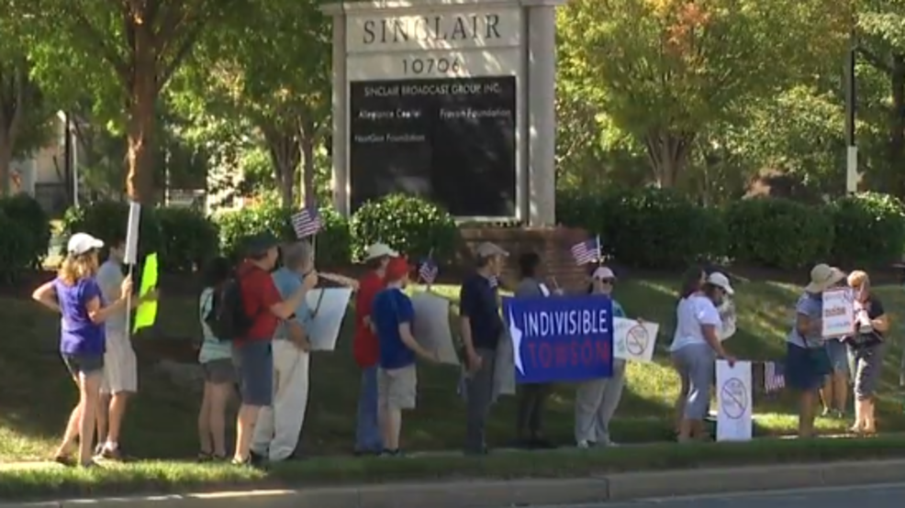
Investigative Questions:
How does the video show the state of US politics and media?
What events led to the video being made?
What is the video supposed to represent?
Why is the video edited in the way that it is?

Slide 4


Hypothesis:
The video represents the fight back against the massive amounts of money and influence invested by conservative groups
Shows the goals and intents of left-leaning groups
It shows the divide in the country between left and right

Slide 5
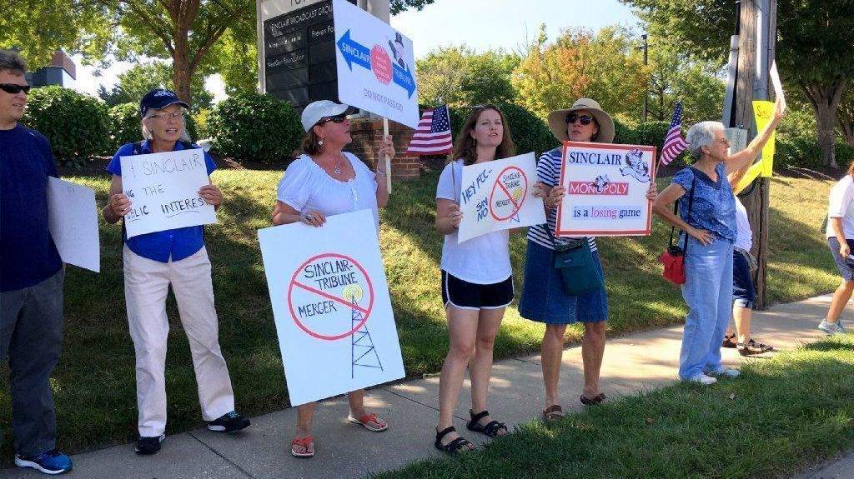

Research Methods:
Analysis of video to explain and support hypothesis
Background of video:
  Sinclair Group and other similar organizations
  Deadspin and other similar organizations
Background of historical events that led to current status quo
Current actions and future moves?

